Slide 1

CPSC-483 Introduction to Machine Learning
Final Project
Dr. Yu Bai
Computer Engineering Program

Slide 2

Hospital Case Cost Prediction Models
Sonal Mogra
Nathan Mayne
Gautam Aneja

Slide 3
Contributions
Our Code:
https://github.com/nmayne3/CPSC-483-Final-Project/tree/main
Code Used:
https://github.com/ojndebbio/Health-Insurance-Prediction-Cost-in-USA-using-Machine-Learning/blob/master/data_worksheet.ipynb
Our Contributions:
Parts of the code were used for Pre-ML data analysis, and we expanded the ML model to factor in Sex, Region, and Number of Children.
Added Linear, Bayesian, and Random Forest regression models and analyzed the effectiveness of the various models using their R2 and RMSE values

Slide 4
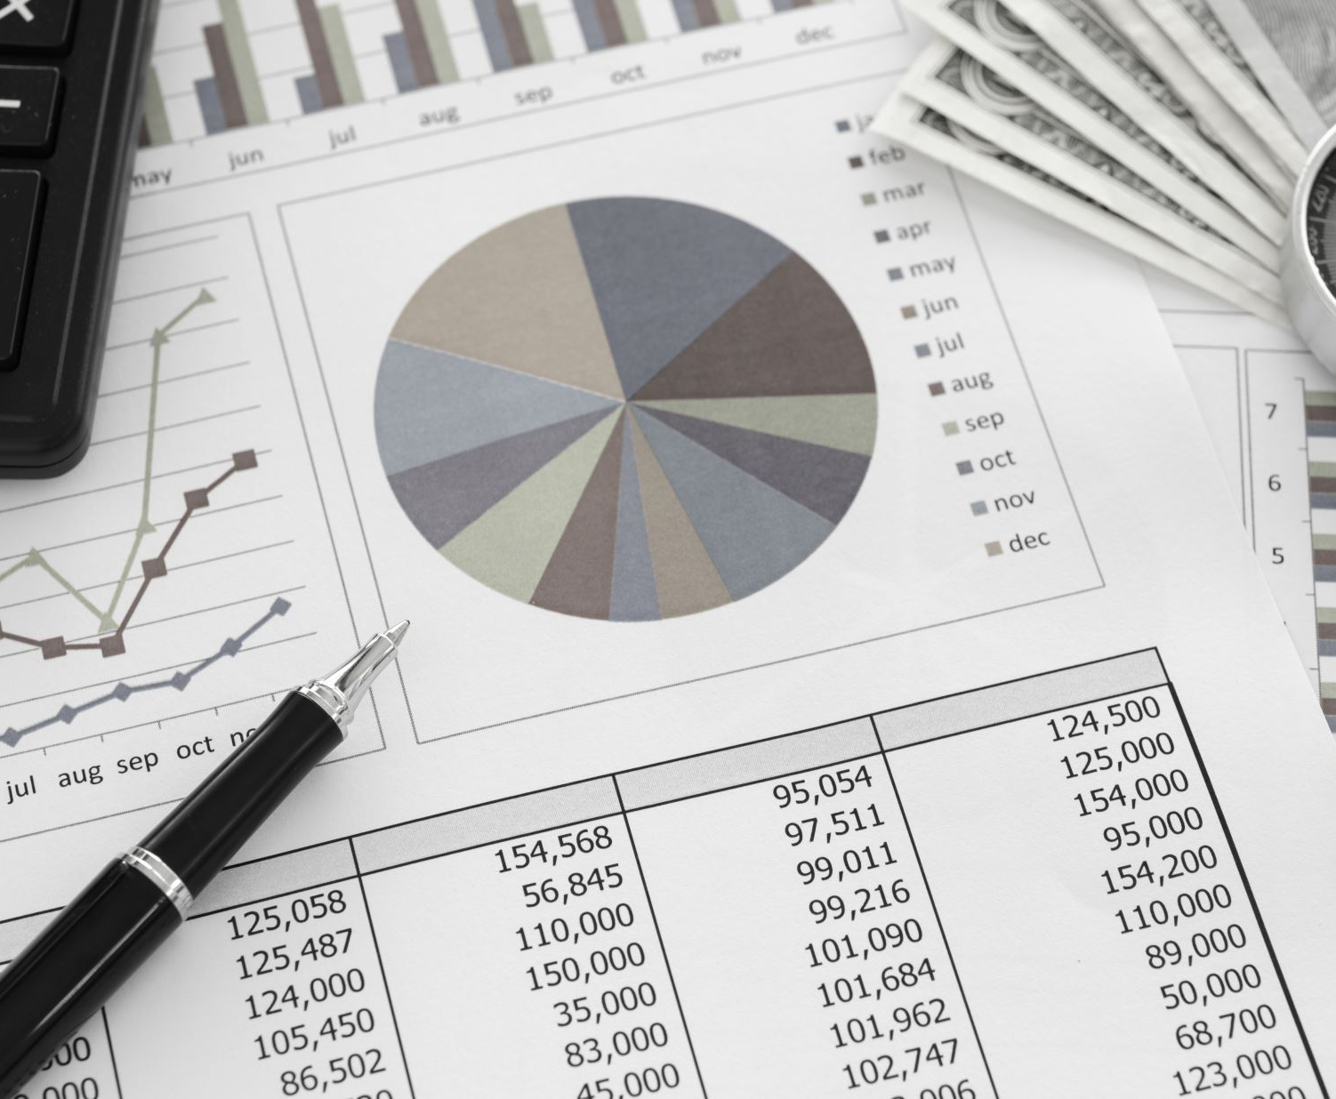
Objective The experiment aimed to assess different regression machine learning models for predicting hospital case costs, seeking superior performance to advance further analysis.
Linear regression techniques were employed and rigorously evaluated to determine their effectiveness in cost estimation. The goal was to identify models exhibiting higher accuracy and precision in forecasting hospital case expenses, forming a basis for deeper investigation and potential implementation in healthcare cost management systems.

Slide 5


Overview of the Project

Slide 6
This predictive model is to estimate hospital charges for patients prior to admission, particularly for elective procedures. This model serves two primary purposes:
It allows patients to financially prepare for their hospital stay
It aids insurance companies in forecasting potential claims.
The implementation of such a model would be a significant step towards financial transparency in healthcare, providing both patients and payers with a tool to better manage and anticipate healthcare costs. The model would typically involve data science techniques such as regression analysis, machine learning models
Problem Statement:
Developing an accurate predictive model to estimate hospital charges prior to a patient's elective admission, enabling individuals to effectively plan their healthcare finances and insurance companies to anticipate claim amounts with greater precision.

Slide 7

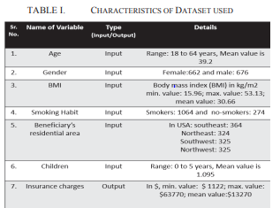
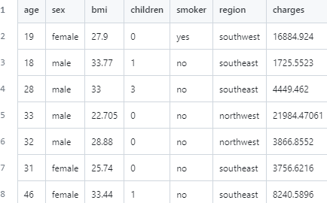
Dataset Description
DATASET DESCRIPTION We will utilize the data from github to solve the cost prediction task. Numerous observations on costs in four USA regions will be gather.
Few entries from the dataset are also shown in figure 1 below. Also, the columns are self-explanatory. The detail of each column is given in table 1.
Table 1
Fig 1

Slide 8
Load the data: Begin by importing the dataset that will be used to train and test the model.
Learn from the data: Understand the dataset through exploratory data analysis to identify patterns, outliers, and underlying structures.
Analyze information and graphically represent numerical categories: Visualize the data to gain insights and understand the relationships between different numerical categories.
Convert object categories to label (dummy) variables: Preprocess categorical data by converting it into a numerical format that can be interpreted by the model (e.g., through one-hot encoding).
Import and fit Linear Regression models: Select the Linear Regression algorithm from a library and apply it to the processed data to create a model.
Predict values using the fitted model: Use the model to make predictions on new or test data.
Measure accuracy of the model: Evaluate the model's performance using appropriate metrics to determine its accuracy in making predictions
Methodology
1
2
3
4
5
6
7

Slide 9

Steps for predicting the hospital cost

Slide 10
1. Loading the libraries and modules: : All the required libraries and modules will loaded into the Google Collab.
4. Creating a new feature that distinguishes obese and non-obese individuals
2. Loading Data: Next, data will be downloaded from Kaggle will be uploaded in the project after cleaning and filtrations.
3. Define a function to distinguish (e.g.smokers and non-smokers): By dividing incoming independent factors into multiple extra variables, a dataset will be modified to the kind that allows machine learning algorithms to be used (binary system). The Smoker column, in an instance, will be broken into two categories: female smokers and male smokers. Other independent variables will be subject to similar processes
5. After obtaining the Linear Regression coefficients, we define a function that automatically predicts hospital cost value given age, obesity and smoking parameters.

Slide 11
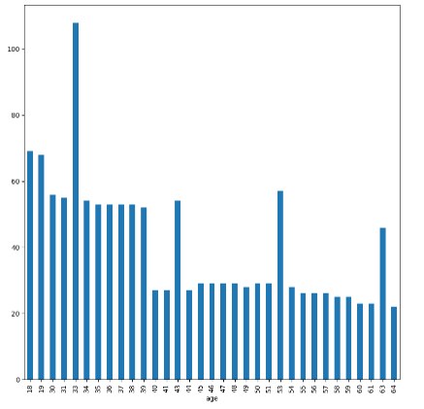
Age vs charges
From this visual we can see that people around the age 33, do spend more on Hospitals than any other age group

Slide 12
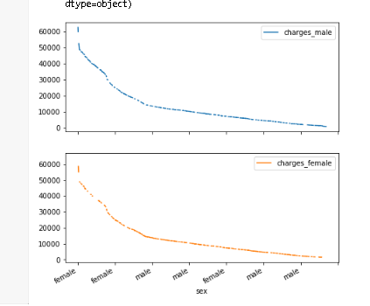
Gender vs charges
From this visual we can suggest that charges of insurance has no effect on gender, it is unbiased

Slide 13
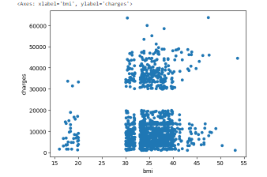
Bmi vs charges
From this visual we can suggest that as BMI increases we can see increase in charges

Slide 14
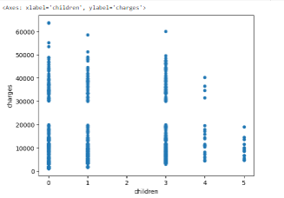
Children vs charges
From this visual we can suggest that as People with no children do spend more on charges , rather those people that has 4 5 children,

Slide 15
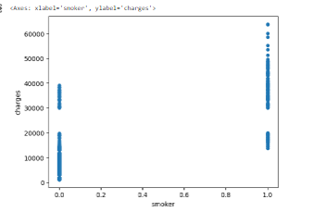
Smoker vs charges
From this visual we can suggest that in obvious real-world scenario, that non-smokers do spend less on Hospital than smokers

Slide 16
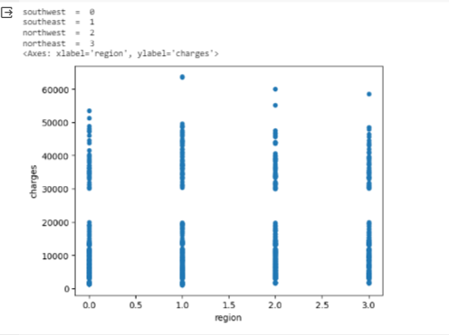
Region vs charges
From this visual we can suggest that Southeast spend more on hospital than rest part of the USA

Slide 17
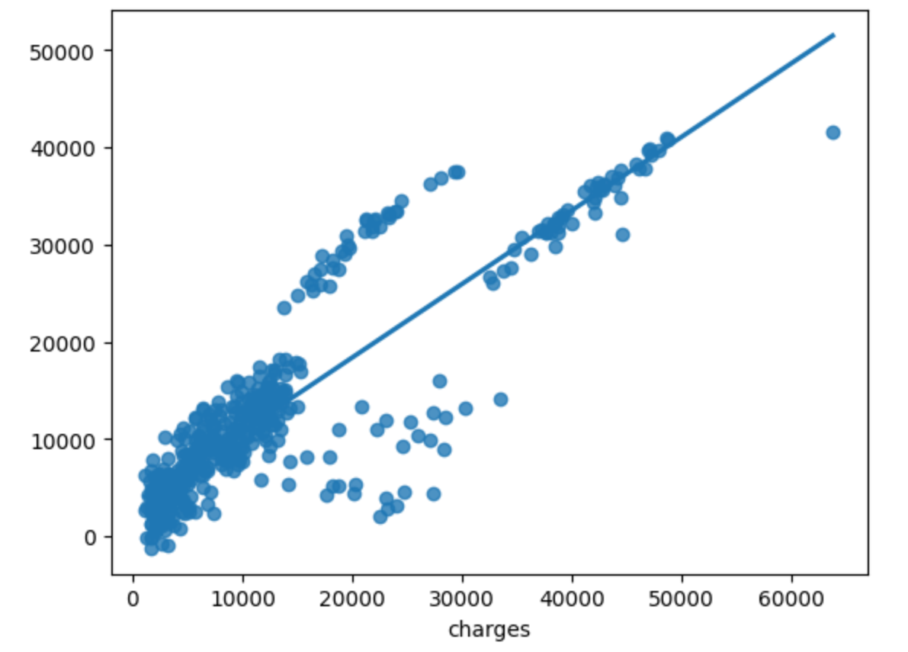
Linear Regression
Comparing Predicted Charges to Actual Charges
Here, we can see that linear regression, while certainly demonstrating a trend, is not a perfect fit for the data

Slide 18
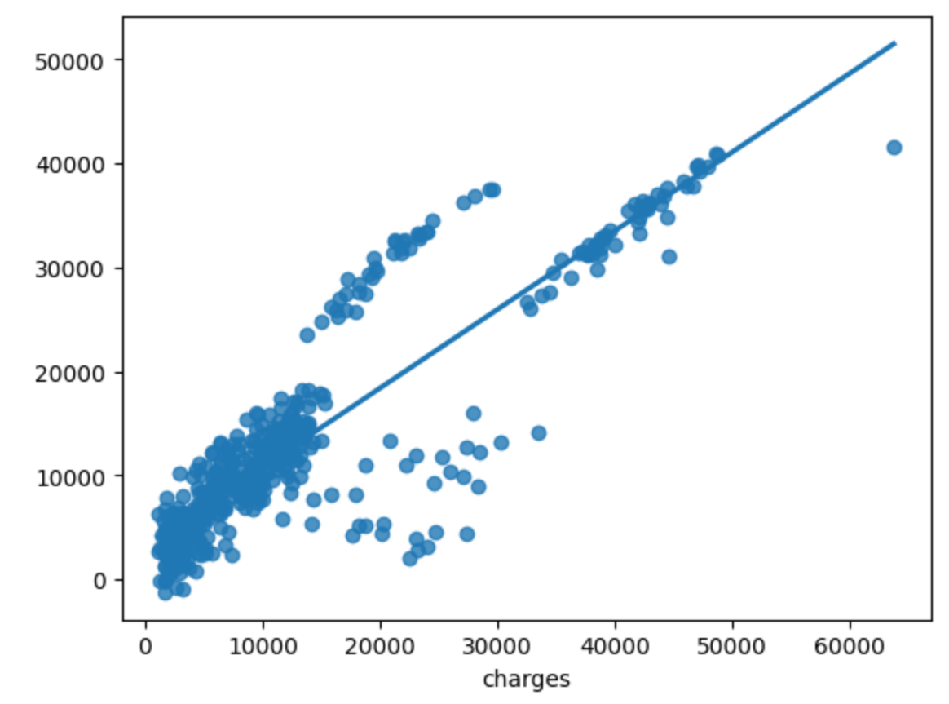
Bayesian Regression
This looks familiar
At larger sized datasets, Linear Regression models can often make very similar predictions

Slide 19
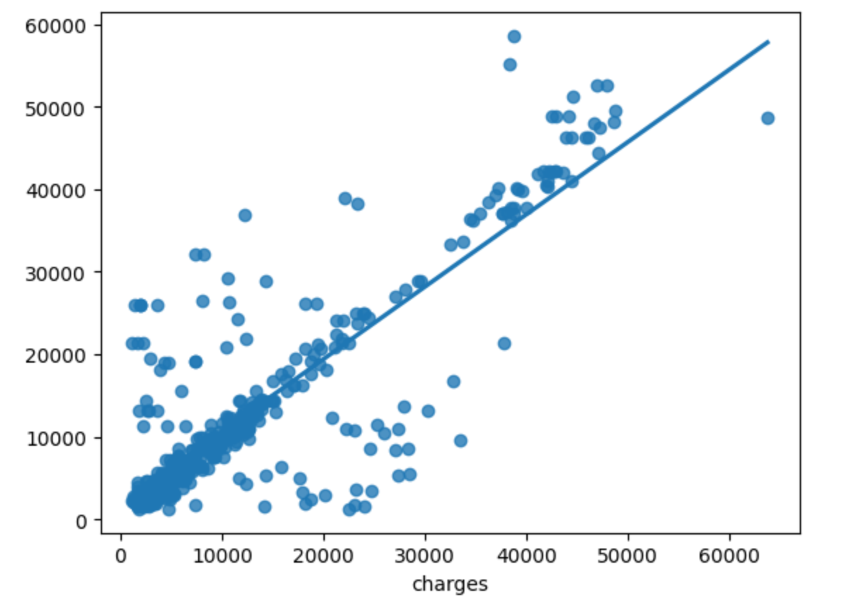
Decision Trees
More consistent in shape, but a wider spread
This change in shape is likely because decision trees are non-linear models, so they can better represent non-linear data

Slide 20
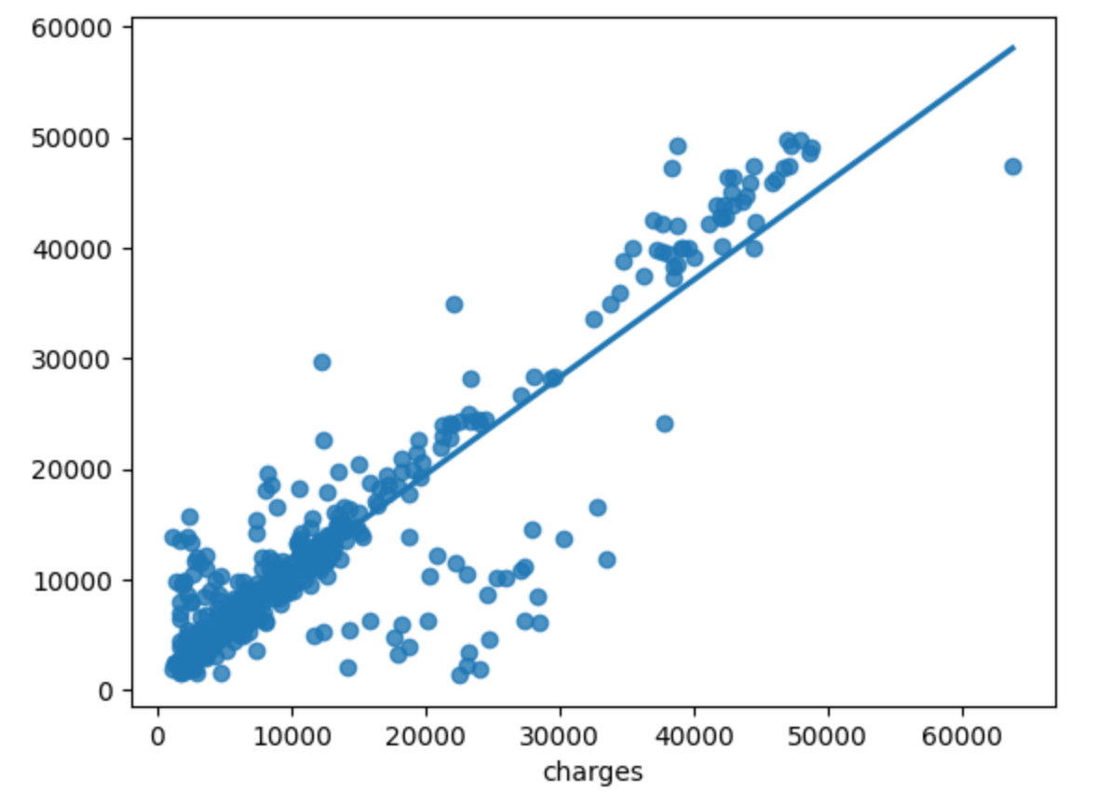
Random Forest Regressor
This looks better
A type of Decision Tree model, which uses bagging to create multiple smaller trees and averages their predictions
Tighter fit likely the result of bagging

Slide 21
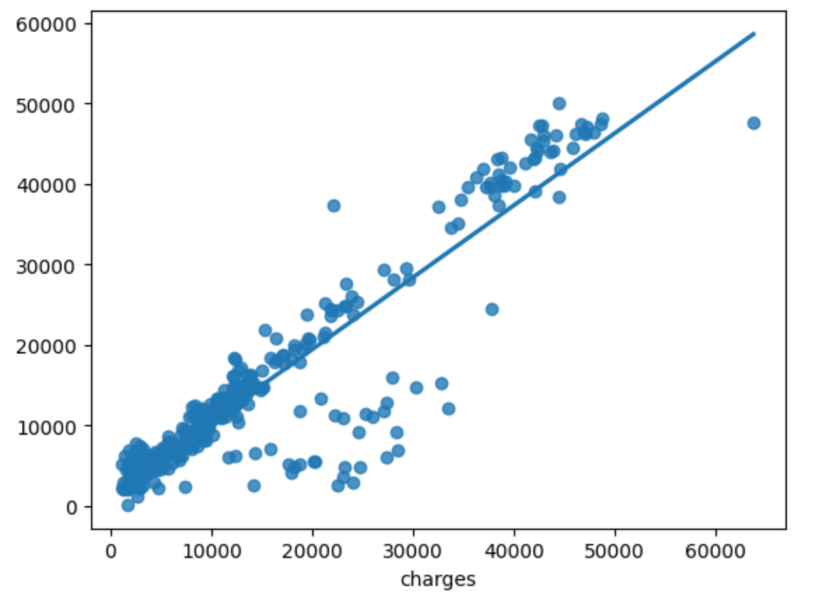
Gradient Boosting Regressor
Similar, but slightly less spread
ANOTHER Decision Tree Regression model
Unlike Random Forest in that it works by building decision trees one by one, and combining the results throughout the process rather than at the end

Slide 22
Comparing the r² and RMSE values
ML model | r² Value | RMSE score
Linear Regression | 0.755540757797331 | 5985.33169782851
Bayesian Regression | 0.7555907121584804 | 5984.720126151663
Decision Tree Regression | 0.6904108421195101 | 6735.62444140085
Random Forest Regression | 0.8129953095401143 | 5234.934385197414
Gradient Boosting Regression | 0.8501952212495782 | 4685.412442455026
Looking at the values, we can see that Gradient Boosting Regression is the most accurate model

Slide 23
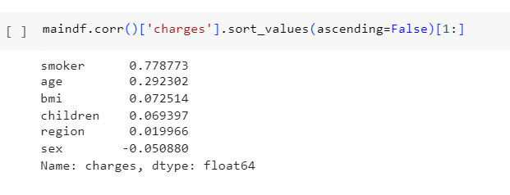
Correlation of each variable with charges
Smokers columns is highest when correlated with money spent on hospital

Slide 24
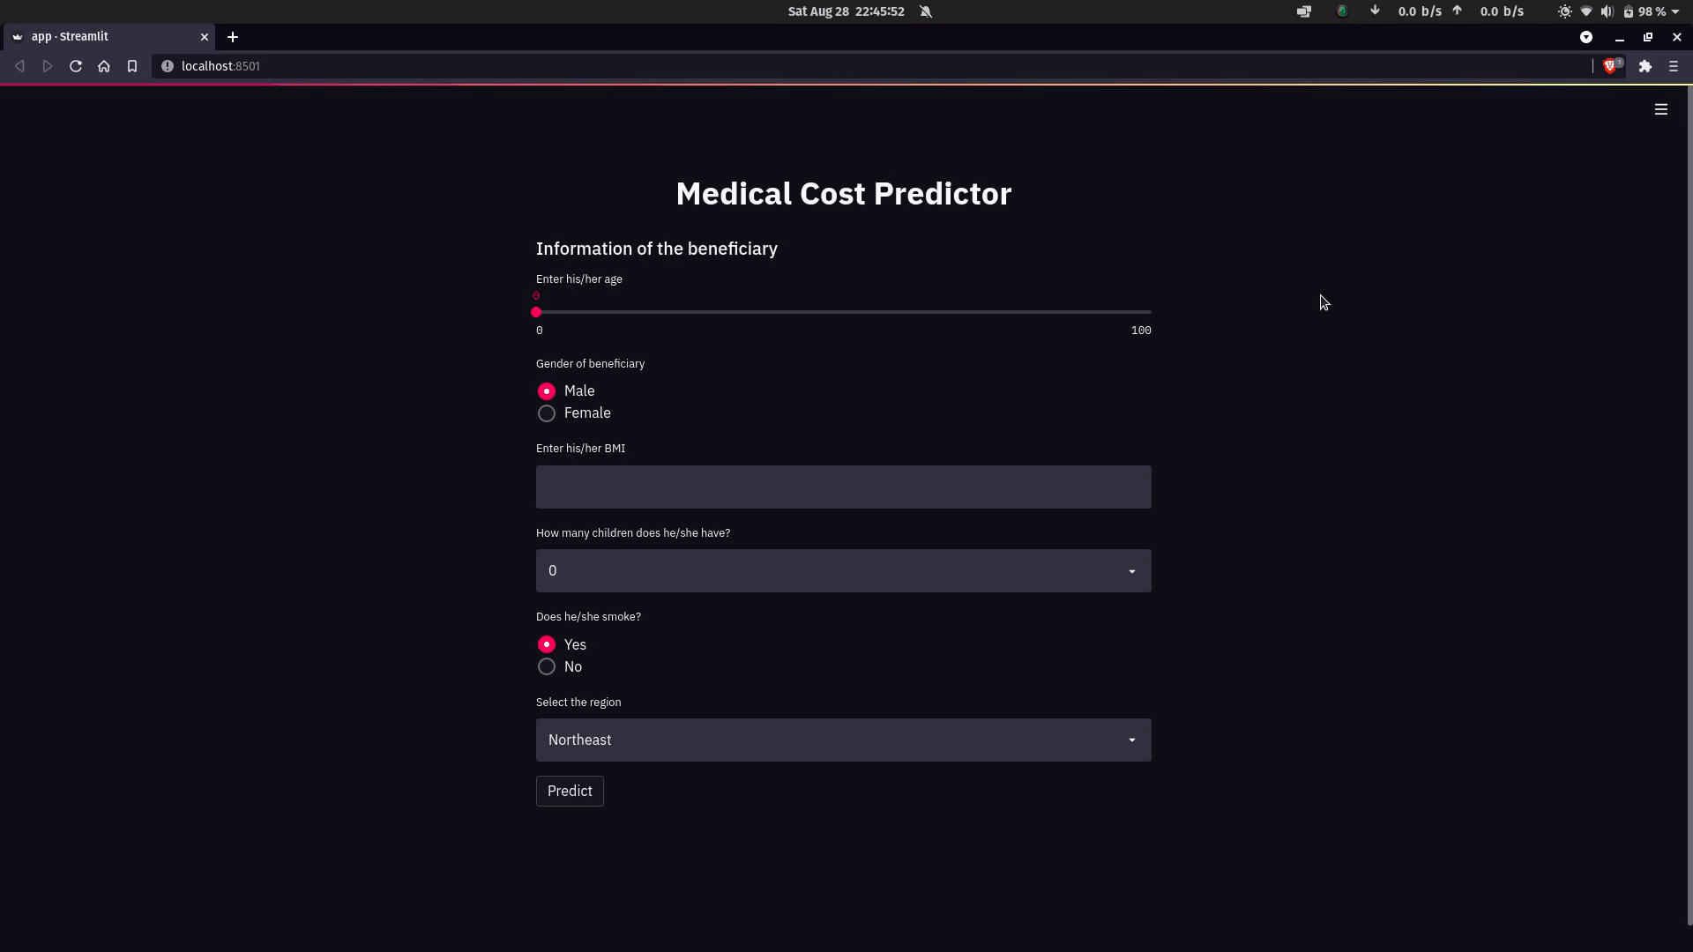
Proof of Concept

Slide 25
References
https://ieeexplore.ieee.org/stamp/stamp.jsp?tp=&arnumber=9824201&tag=1
https://mmilovanovic87.github.io/LinearRegression/

Slide 26


Thank You.

